Slide 1

SQL, RDBMS & Data Viz
An introduction to SQL, Relational Database Management Systems and Data Visualization.
MATH 290.2 - Lecture 3
Balázs Zombory | Data Architect | MongoDB

Slide 2
Coding Interview
Everybody deserves 10 minutes of fame

Slide 3
State the problem clearly.
State the assumptions you made.
Do
State your tools and methods you picked.
Explain how the code solves the problem.
Address potential blindspots.
Have fun with it.

Slide 4
Homework Review
Knowledge Base
Relational Algebra, a Primer
SQL Constraints
Postgres Architecture Review
SQL Syntax Review
DDL vs DML
PowerBI
Lab Work

Slide 5
Homework Review
An expected error

Slide 6

Escalation
Try and solve it yourself
Ask Slack
Ask Google
Ask the Prof.

Slide 7
Asking the Prof...
Make sure nobody asked this question on the channel
It isn’t easy to find on Google
Write your question up in a document
Explain clearly what you have done to resolve it
Include steps and screenshots (including the error message)

Slide 8
If the Prof helps...
You are required to:
1) Create a Knowledge Base Article
2) Populate the necessary fields in the KB

Slide 9
Error 1 - File too large
SQL Error [XX000]: ERROR: could not stat file "C:\Users\User Name\Desktop\Spring2021\MA2902\2018_Yellow_Taxi_Trip_Data.csv": value too large
copy table_name from program 'cmd /c "type x:\path\to\file.csv"' delimineter ‘,’ CSV HEADER;

Slide 10
Error 2 - permission denied
Couldn’t open the file for reading: permission denied. Hint: COPY FROM instructs the postgresql server process to read a file. You may want a client-side facility such as psql’s \copy
Discussion

Slide 11
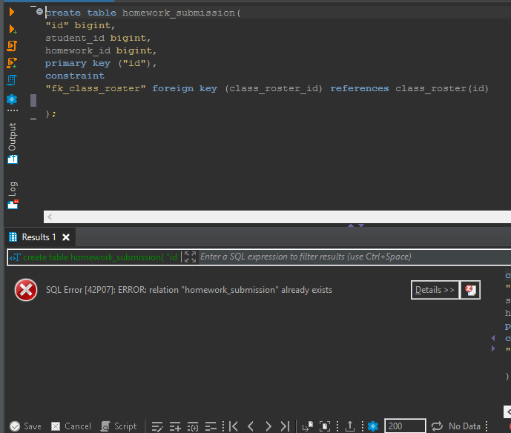
Error 3 - Relation already exists

Slide 12
Relational Algebra, a Primer
An introduction to some tuple operators

Slide 13
Relational Algebra is...
a procedural query language that:
1) takes a relation as input
2) applies relational algebra operator
3) outputs another relation
Relation is like a table
Tuple is like a row
Attribute is like a column

Slide 14
Projection (π)
Selection (σ)
Union (U)
Set Difference (-)
Cross Product(X)

Slide 15
Projection (π)
Used to project required attributes from a relation
Removes duplicate values
What is π(BC)?
R
A | B | C
1 | 2 | 4
2 | 2 | 3
3 | 2 | 3
4 | 3 | 4

Slide 16
What is π(BC)?
Used to project required attributes from a relation
Removes duplicate values
R
B | C
2 | 4
2 | 3
3 | 4

Slide 17
Selection (σ)
Used to select required tuples from a relation
Using the same relation
What is σ(C>3)R ?
R
A | B | C
1 | 2 | 4
2 | 2 | 3
3 | 2 | 3
4 | 3 | 4

Slide 18
What is σ(C>3)R
Used to select required tuples from a relation
Is this right?
R
A | B | C
1 | 2 | 4
2 | 2 | 3
3 | 2 | 3
4 | 3 | 4

Slide 19
What is π(σ(C>3)R)
Used to select required tuples from a relation
Will it actually show?
R
A | B | C
1 | 2 | 4
4 | 3 | 4

Slide 20
Union (U)
Same as in set theory:
Attributes needs to be the same
Results are relations and sets at the same time
UNION command (2 select statements)

Slide 21
Set Difference (-)
Same as in set theory:
both relations should have the same set of attributes
EXCEPT operator
2 SELECT statements

Slide 22
Cross Product(X)
Enforced by:
Returns all attributes of A followed by each attribute of A
the , operator
SELECT * FROM TABLE_A, TABLE_B

Slide 23
What is A X B?
A
Name | Age | Interest
Frank | 24 | music
Sonia | 32 | math
B
ID | Course
1 | RDBMS
2 | Calculus

Slide 24
What is A X B?
B
ID | Course
1 | RDBMS
2 | Calculus
AXB
Name | Age | Interest | ID | Course
Frank | 24 | music | 1 | RDBMS
Sonia | 32 | math

Slide 25
SQL Constraints
When and how should you use them?

Slide 26
NOT NULL
UNIQUE
PRIMARY KEY
FOREIGN KEY
CHECK
HOW TO DROP THEM?

Slide 27
NOT NULL
Enforces that an attribute cannot have NULL value
By default a Primary Key cannot be NULL
Pair it with an attribute during schema definition

Slide 28
NOT NULL
create table students(
id INT Primary KEY NOT NULL,
f_name varchar NOT NULL,
l_name varchar NOT NULL
);

Slide 29
UNIQUE
Prevents two identical records in an attribute
use it wisely
put the UNIQUE command after the attribute definition in your relation

Slide 30
UNIQUE
create table students(
id INT Primary KEY NOT NULL,
f_name varchar NOT NULL,
l_name varchar NOT NULL,
age int NOT NULL UNIQUE -- Does this make sense?
);

Slide 31
PRIMARY KEY
Unique key that identifies each tuple (row) in the relation (table).
The column is going to be UNIQUE
You need Primary Keys in your data model to build relations between tables.

Slide 32
PRIMARY KEY
create table students(
id INT PRIMARY KEY NOT NULL,
f_name varchar NOT NULL,
l_name varchar NOT NULL,
age int NOT NULL
);

Slide 33
FOREIGN KEY
In its most simple way a foreign key is a column in one table matches another column in another table.
Does not need to be UNIQUE
requires the existence of a PRIMARY KEY constraint

Slide 34
FOREIGN KEY
create table students(
id INT PRIMARY KEY NOT NULL,
f_name varchar NOT NULL,
l_name varchar NOT NULL,
age int NOT NULL
);
create table student_interests(
id INT PRIMARY KEY NOT NULL,
student_id INT references students(ID)
interest varchar NOT NULL
);

Slide 35
CHECK
Enforces a adherence to a condition defined in the schema
Applied to the column
column doesn’t need to be UNIQUE

Slide 36
CHECK
create table students(
id INT PRIMARY KEY NOT NULL,
f_name varchar NOT NULL,
l_name varchar NOT NULL,
age int NOT NULL CHECK (age>0)
);

Slide 37
DROP CONSTRAINTS
Enforced by:
Indexes
UNIQUE command
PRIMARY KEY constraint

Slide 38
DROP CONSTRAINTS
ALTER TABLE students DROP CONSTRAINT students_age_check;
(
id INT PRIMARY KEY NOT NULL,
f_name varchar NOT NULL,
l_name varchar NOT NULL,
age int NOT NULL CHECK (age>0) -- the check constraint will be removed
);

Slide 39
Postgres Architecture
Introduction to client-server relationship

Slide 40

Client-Server relationship

Slide 41
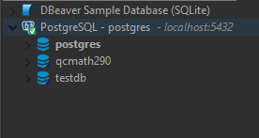
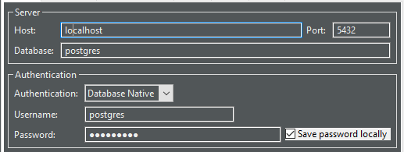
Initialized a server locally

Slide 42
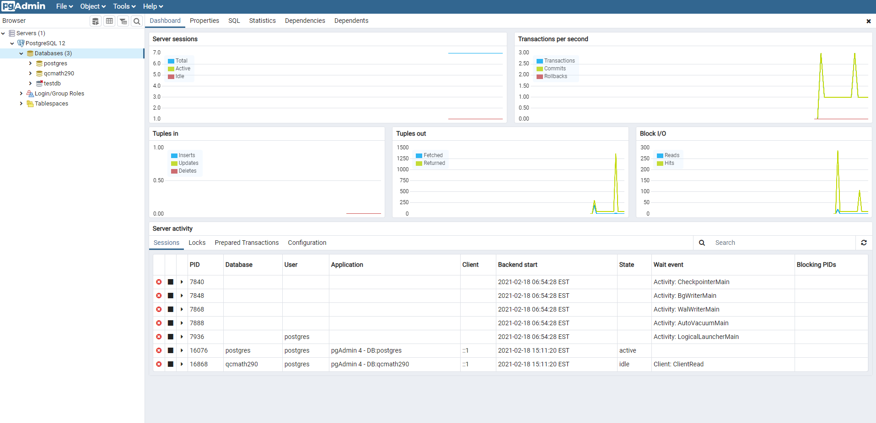
pgAdmin - Monitor the server

Slide 43
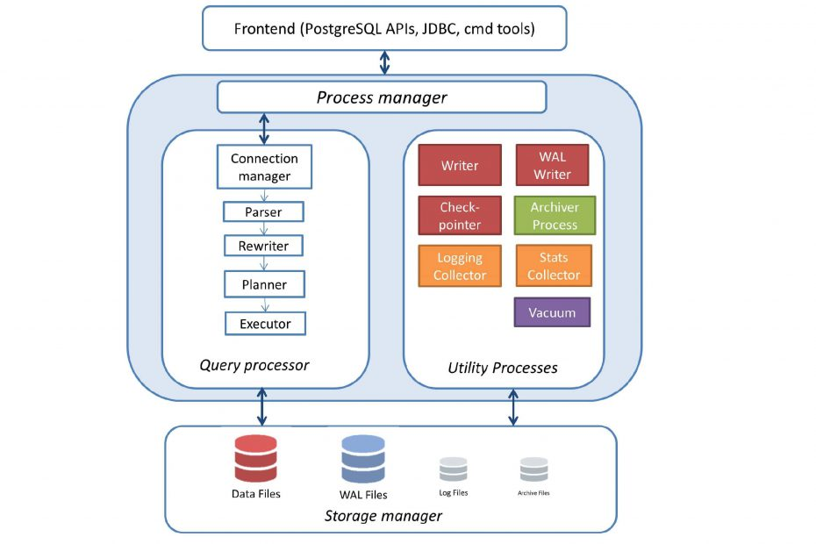
Postgres Architecture

Slide 44
Lab Session
Class exercises.

Slide 45
Task 1
Gain access to the MATH 290.2 Spring 2021 Google Sheet
Make sure that your name is on the list
Under column passion populate it with your own

Slide 46
Thank you
Questions?
Balázs Zombory | Data Architect | MongoDB

